Slide 1
Outline
Agents and environments
Task environment (PEAS)
Types of agent

Slide 2
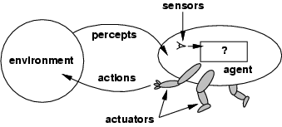
Intelligent Agents and their Environments
An agent:
– Perceives its environment,
– Through its sensors [percepts],
– Then achieves its goals
– By acting on its environment via actuators [actions]

Slide 3
Task Environment - PEAS (1)
To design a rational agent, we must first specify the task environment:
PEAS: Performance measure, Environment, Actuators, Sensors
Consider, e.g., the task of designing an automated taxi driver:
Performance measure?? Environment??
Actuators??
Sensors??

Slide 4
Rational agent
A rational agent always performs right action, where the right action means the action that causes the agent to be most successful in the given percept sequence.

Slide 5
PEAS (2)
Consider the task of designing PEAS for:
An automated taxi driver agent:
Performance measure: Safe, fast, legal, comfortable trip, maximize profits Environment: Roads, other traffic, pedestrians, customers Actuators: Steering wheel, accelerator, brake, signal, horn Sensors: Cameras, sonar, speedometer, GPS, odometer, engine sensors, keyboard
An Internet shopping agent
Performance measure: price, quality, appropriateness, efficiency
Environment: current and future WWW sites, vendors, shippers
Actuators: display to user, follow URL, fill in form
Sensors: HTML pages (text, graphics, scripts)

Slide 6
PEAS (3)
PEAS for a refinery controller
Performance measure: maximize purity, yield, safety
Environment: refinery, operators
Actuators: valves, pumps, heaters, displays
Sensors: temperature, pressure, chemical sensors
PEAS for an Interactive English tutor
Performance measure: Maximize student's score on test
Environment: Set of students
Actuators: Screen display (exercises, suggestions, corrections)
Sensors: Keyboard/mouse

Slide 7
Types of agent
Four basic types of agent in order of increasing generality:
Simple reflex agents
Model-based reflex agents
Goal-based agents
Utility-based agents

Slide 8
Simple Reflex Agents
Action depends only on immediate percepts.
Implemented by condition-action rules.
Example:
Agent: Mail sorting robot
Environment: Conveyor belt of letters
Rule: e.g. city = Cov →put West Midlands bag
Simple-reflex agents are simple, but they turn out
to be of very limited intelligence
The agent will work only if the correct decision
can be made on the basis of the current percept –
that is only if the environment is fully observable

Slide 9
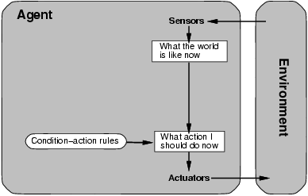
Simple Reflex Agents

Slide 10
Model-Based Reflex Agents
Action may depend on history or unperceived aspects of the world.
Need to maintain internal world model.
The agent should keep track of the part of the world it can't see
Example:
Agent: robot vacuum cleaner
Environment: dirty room, furniture.
Model: map of room, areas already cleaned.
Sensor/model tradeoff.
Updating the internal state information as time goes by requires two kinds of knowledge to be encoded in the agent program:
– Information about how the world evolves independently of the
agent
– Information about how the agent's own actions affects the world

Slide 11
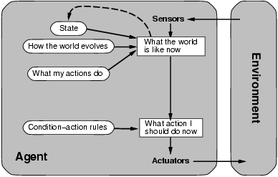
Model-Based Reflex Agents

Slide 12
Goal-Based Agents
Agents so far have fixed, implicit goals.
We want agents with variable goals.
Forming plans to achieve goals is an important issue.
Example:
Agent: robot maid
Environment: house & people.
Goals: clean clothes, tidy room, table laid, etc
The agent needs some sort of goal information that describes situations that are desirable
The agent program can combine this with information about the results of possible actions in order to choose actions that achieve the goal

Slide 13
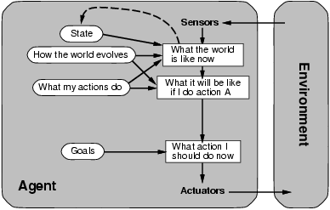
Goal-Based Agents

Slide 14
Goal-based agents vs reflex-based agents
Although a goal-based agent appears less efficient, it
is more flexible because the knowledge that
supports its decision is represented explicitly and
can be modified
On the other hand, for the reflex-based agent, many condition-action rules have to be rewritten
The goal based agent's behaviour can easily be changed
The reflex agent's rules must be changed for each new
situation

Slide 15
Utility-Based Agents
Agents so far have had a single goal.
Agents may have to juggle conflicting goals.
Need to optimise utility over a range of goals.
Utility: measure of goodness (a real number).
Combine with probability of success to get expected utility.
Example:
Agent: automatic car.
Environment: roads, vehicles, signs, etc.
Goals: stay safe, reach destination, be quick, obey law,
save fuel, etc.

Slide 16
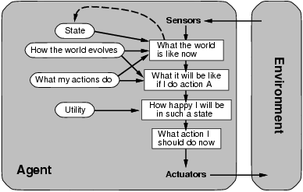
Utility-Based Agents

Slide 17
Learning Agents
Instead of actually programming
intelligent machines/agents by hand, which is a
demanding task, it is easier to build learning
agents/machines and then teach them
Learning also allows the agent to operate in initially unknown environments and to become more competent as its knowledge/learning increases

Slide 18
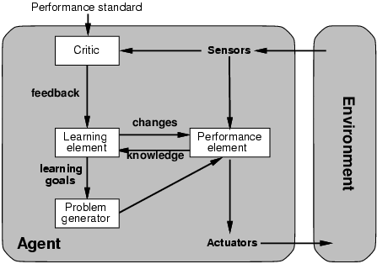
Learning Agents

Slide 19
Learning Agents
Learning element – responsible for making improvements
Performance element – responsible for selecting
external actions
Learning element uses feedback from the critic on how the agent is doing and determines how the performance element should be modified to do better in the future
Problem generator is responsible for suggesting actions that will lead to a new and informative experiences

Slide 20
Consolidation questions
Using a suitable diagram and explain how an agent interacts with its environment.
In agent technology the task environment is often specified using PEAS.
Explain what PEAS stands for
Specify the PEAS for the following agents:
an interactive English tutor agent and
an automated taxi driver agent.
Identify the four types of agent and list their characteristics.
Describe an example of a simple reflex agent.
What are the advantages of a goal-based agent.
Explain why a utility function/measure is useful.

